Slide 1
SWE2315 : System ANALYSIS & DESIGN
Lecture 03: Analysis
At: CIT Theater
By: 2-4pm

Slide 2
Outline
The analysis phase.
Requirement determination.
Requirement elicitation techniques.
Requirement analysis strategies.
System Proposal

Slide 3
The Analysis Phase
Analysis refers to breaking a whole into its parts with the intent of understanding the parts’ nature, functions, and interrelationships.
The planning phase deliverables are the key inputs into the analysis phase.
The basic process of analysis involves three steps:
1. Understand the existing situation (the as-is system)
2. Identify improvements
3. Define the requirement for the new system (the to-be system).

Slide 4
1. Understanding Existing Situation
Sometimes the first step is skipped or done in a limited manner.
This happens when no current system exists, if the existing system and processes are irrelevant to the future system, or if the project team is using agile development methodology.
Traditional SDLCs allot significant time to understanding the as-is system while newer SDLCs do not.
Experience shows that it is useful to study the current situation whenever possible.

Slide 5
2. Identify Improvement
Critical thinking is the ability to recognize strengths and weaknesses and recast an idea in an improved form.
Analyst needs critical thinking to understand issues with existing system and develop new and improved business processes.
Example : a user states that the new system should “eliminate inventory stock-outs.”
The analyst needs to think about it critically in order to formulate the statement in terms of useful requirements.

Slide 6
Example: Eliminate Inventory Stock-out
The analyst could first have the users think about circumstances leading to stock-outs (e.g., supplier orders are not placed in a timely way),
Then look at the issues that lead to supplier orders not placed (e.g.,
on-hand inventory levels are updated weekly;
delays occur in identifying the best supply source for the items;
delays occur in receiving approval of the supply order, etc.)
By focusing on these issues, improvements to address these concerns can be discovered.

Slide 7
3. Requirements for new System
The new requirements will then be based on the issues that truly need to be fixed. From example(eliminate Inventory stock out):
Issue : on-hand inventory levels are updated weekly;
Requirement for New System: The system shall update on-hand inventory levels twice per day.
Issue: delays occur in identifying the best supply source for the items;
Requirement for New System: The system shall include a recommended supplier with every out-of-stock notification.
Issue: delays occur in receiving approval of the supply order,
Requirement for New System: The system shall send an approved supply purchase order to the supplier via secure electronic communication.

Slide 8
3. Requirements for new System
The analyst cannot realistically expect that the true requirements for the new system are easily gathered following a few conversations with the stakeholders.
The analyst must be prepared to dig into the situation and discover requirements.
A number of techniques and tools can be used by the analyst to facilitate this process of discovering requirements.

Slide 9
Requirements Determination
Requirements determination is performed to:
transform the system request’s business requirements into a more detailed precise list of what the new system must do to provide the needed value to the business.
This detailed list of requirements is supported, confirmed, and clarified by the other activities of the analysis phase: creating use cases, building process models, and building a data model.

Slide 10
Requirements
A requirement is simply a statement of what the system must do or what characteristics it needs to have.
During a systems development project requirements will be created that describe :
what the business needs (business requirements);
what the users need to do (user requirements);
what the software should do (functional requirements);
characteristics the system should have (nonfunctional requirements);

Slide 11
Business Requirements
These statements reflect the business requirements that the system, if built, will fulfill.
Examples “Increase market share”; “Shorten order processing time”; “Lower inventory spoilage”.
Success of the software will be measured by evaluating whether the stated business requirements have actually been achieved.

Slide 12
User Requirements
User requirements describe tasks that the users perform as an integral part of the business’ operations,
Example:
“Schedule client appointment”;
“Place customer order”;
“Re-order inventory”
“Make Payment”

Slide 13
Functional Requirements
Functional requirements begin to define how the system will support the user in completing a task.
For example, assume the user requirement is “Schedule a client appointment.”
The functional requirements associated with that task (“Schedule a client appointment.”) include:
Determine client availability
Find available openings matching client availability
Select desired appointment
Confirm appointment

Slide 14
Non-Functional Requirements
Nonfunctional requirements describe a variety of system characteristics:
Operational:The physical and technical environments which the system will operate
Performance:The speed, capacity, and reliability of the system
Security:Who has authorized access to the system under what circumstances
Cultural and political:Cultural and political factors and legal requirements that affect the system
Nonfunctional requirements are primarily used in the design phase when decisions are made about:
the system’s underlying architecture , the user interface, the hardware and software,

Slide 15
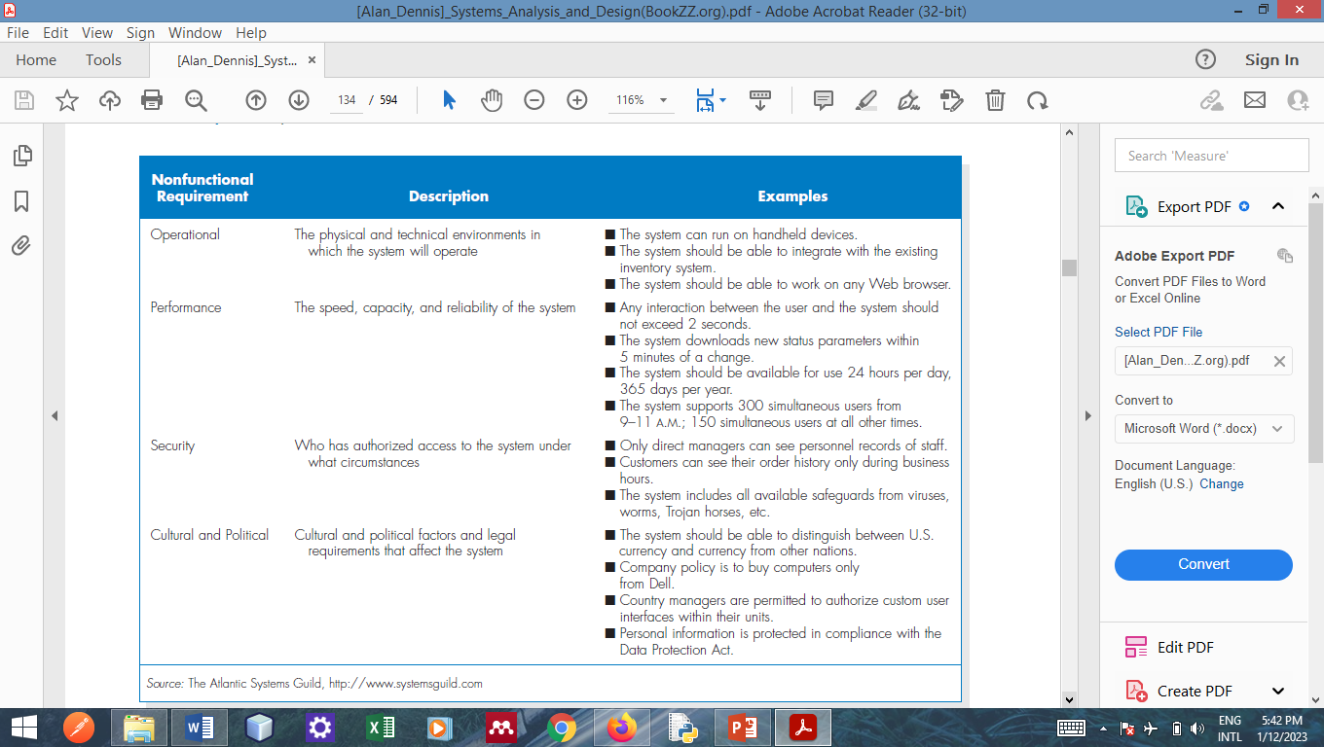
Example-Non-Functional Requirements

Slide 16
Requirements Elicitation
For the analyst to get the business, user, functional and non-functional requirement s/he must elicit (gather)it.
The analyst must consider how best to elicit the requirements from the stakeholders.
There are a variety of elicitation techniques that can be used to acquire information, such as:
interviews,
questionnaires,
observation,
joint application development (JAD),
and document analysis

Slide 17
Interviews
The interview is the most commonly used requirements elicitation technique.
After all, it is natural usually, if you need to know something, you ask someone.
In general, interviews are conducted one on one (one interviewer and one interviewee), but sometimes, due to time constraints, several people are interviewed at the same time.

Slide 18
Interviews Steps
There are five basic steps to the interview process:
selecting interviewees,
designing interview questions,
preparing for the interview,
conducting the interview,
post interview follow-up.

Slide 19
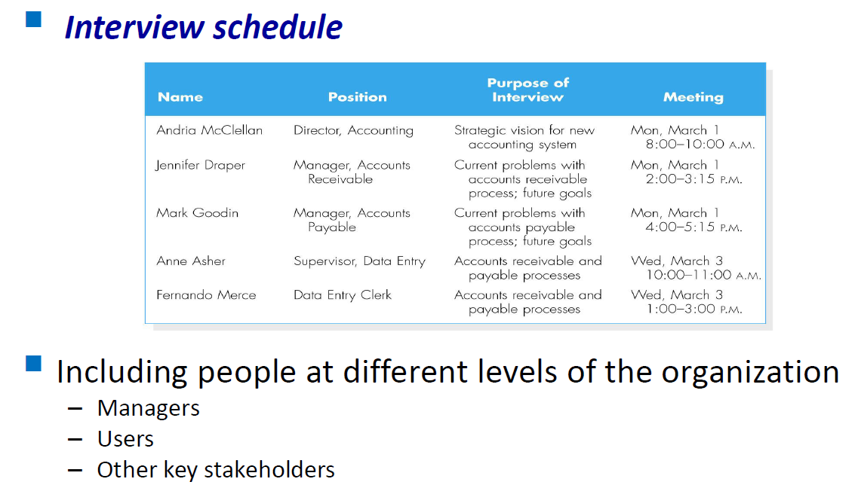
Selecting Interviewees

Slide 20
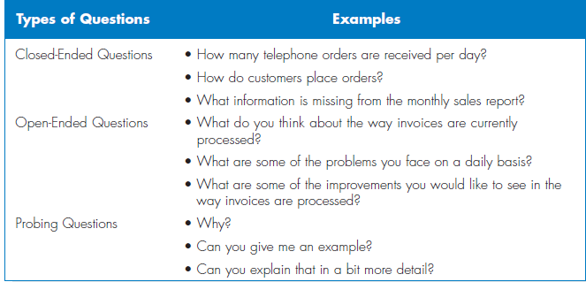
Designing Interview Questions

Slide 21
Preparing for the Interview
Prepare a general interview plan
Confirm areas of knowledge
Set priorities in case of time shortage
Prepare the interviewee
Schedule
Inform of reason for interview
Inform of areas of discussion

Slide 22
Conducting the Interview
Appear to be professional and unbiased.
Record all information.
Be sure you understand the issues that are discussed.
Separate facts from opinions.
Give interviewee time to ask questions, and brief explain what will happen next.
.

Slide 23
Post Interview Follow-up
After the interview, the analysts needs to prepare an interview report.
The report includes interview notes.
The report is sent to interviewee with a request to read it and inform the analyst of clarification and updates.

Slide 24
Joint Application Development (JAD)
JAD is an information gathering technique that allows the project team, users, and management to work together to identify requirements for the system.
JAD is a structure process in which 10 to 20 users meet under the direction of a facilitator skilled in JAD techniques.
The facilitator must be an expert in both group process techniques and systems analysis and design techniques.

Slide 25
JAD Steps
There are five basic steps to the JAD process:
Selecting Participants
Designing JAD Session
Preparing for JAD Session
Conducting the JAD Session
Post JAD Follow-up

Slide 26
Selecting Participants
Selecting JAD participants is done in the same basic way as selecting interview participants.
Participants are selected on the basis of information they can contribute, a broad mix of organizational levels,
The need for all JAD participants to be away from their offices at the same time can be a major problem.

Slide 27
Designing & Preparing for JAD Session
JAD sessions can run from a half day to several weeks depending upon the size and scope of the project.
JAD success depends upon a careful plan.
Most JAD sessions are designed to collect specific information from users.
It is important to prepare the analyst and participants for the JAD session.

Slide 28
Conducting JAD Session
Most JAD sessions follow formal agenda and ground rules.
The JAD facilitator performs three key functions:
Keep session on track, following the agenda.
Help the group understand the technical terms and jargon.
Record group’s input on a public display area.
The facilitator must remain neutral at all time and help the group through the process.
Notes:
Common ground-respecting others’ opinions, accepting disagreement,
Participants are experts in their business area, but they probably are not experts in systems analysis

Slide 29
Post JAD Follow-up
Post session report is prepared and circulated among session attendees
The report should be completed approximately a week to two after the JAD session

Slide 30
Questionnaires
A questionnaire is a set of written questions for obtaining information from individuals.
Four (4) Steps for doing a Questionnaire:
Selecting participants -using a sample of people who are representative of the entire group.
Designing the questionnaire –following good practice guidelines.
Administering the questionnaire –improving the response rates.
Questionnaire follow-up –developing a report.
Notes:
No Preparing step

Slide 31
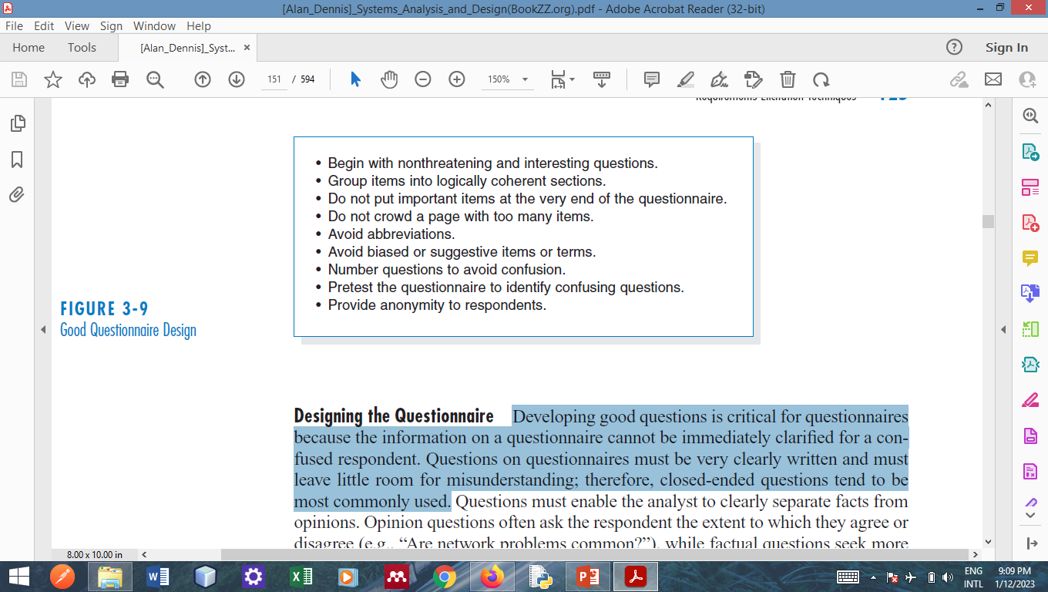
Good Questionnaire Design

Slide 32
Documents Analysis
Document analysis is used to understand the as-is system.
Forms, reports, policy manuals, organization charts describe the formal system that the organization uses.
The indication that system needs to be changed is when users create new forms or make changes to the existing forms/reports.

Slide 33
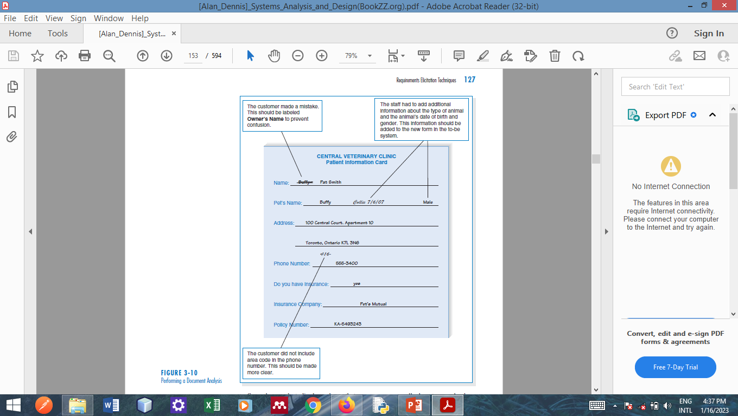
Documents Analysis--Example

Slide 34
Observation

Slide 35
Observation
Observation–the act of watching processes being performed.
It is a powerful tool to gain insight into the as-is system, and to check the validity of information gathered from other sources.
Nonetheless, people tend to be extremely careful in their behaviors when they are being watched.
Notes:
For example, an analyst might become skeptical of someone who claims to use the existing computer system extensively if the computer is never
turned on while the analyst visits

Slide 36
Selecting Elicitation Technique
Each of the requirements elicitation techniques just discussed has strengths and weaknesses.
No one technique is always better than the others, and in practice most projects benefit from a combination of techniques.
Some factors can be used to select the most appropriate.

Slide 37
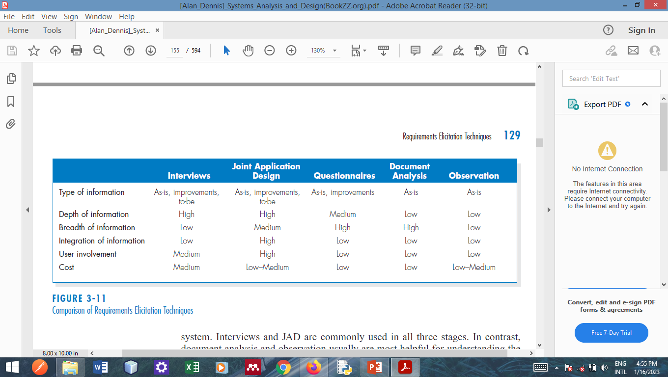
Selecting Elicitation Technique
Notes:
Depth—how rich the info is
Breadth—information sources that can be collected easily

Slide 38
Summary
Analysis focuses on capturing the business requirements for the system
Requirement Determination is the part of analysis in which the project team turns the business requirements stated in the system request into a precise list of requirements.
Five Requirements Elicitation Techniques can be used to elicit requirements.

Slide 39
Group Assignment
Task 1: Project Initiation
The business need that led to the identification of the project.
The System Request –Tabular Format
The Feasibility Report – Tabular Format
Task 2: Planning
The SDLC selected and why
The Work Plan (Draft with only 3 task(planning, analysis and Design)
Task 3: Analysis
The Selected Elicitation technique and why. The elicitation report including the questions used and the answers.
The Four(4) different types of requirements
Refine the Work Plan (break analysis into the two(2) sub-steps above and assign all the tasks to half of the analysis members)

Slide 40
Questions !!!

